Slide 1
VP160 Review Class 1
by Li Chunchao
2016/6/15

Slide 2
Short Review

Slide 3
Solving Problems

Slide 4
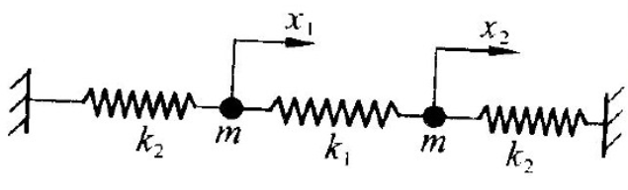

Lagrangian Mechanics
Two particles are fixed by three springs as followed. The particles and springs are all on a table. Find out the equation of motion.

Slide 5
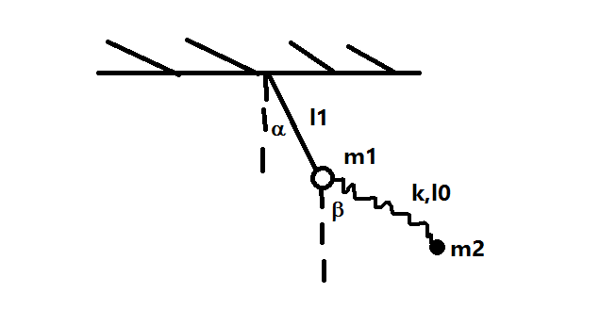
Lagrangian Mechanics
Find out the equation of motion.

Slide 6
Momentum
One day, Mr. Kong want to buy 5kg rice from Mr. Li. Mr. Li dump the rice uniformly. When the reading on the weighter is 5kg. Mr. Li stop dumping. Mr. kong think the final on the weighter is less than 5kg. Is he right?

Slide 7

Collision
Find the speed of two balls after collicsion when
It is an elastic collision
The coefficient of restitution is e.

Slide 8
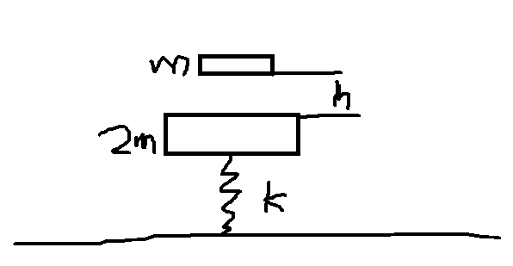
Collision
The collision is elastic. The second collision happened at the same place. All bulks are static as t=0. Find h.

Slide 9

Rocket
Prove Tsiolkovsky rocket equation

Slide 10
Q&A

